Slide 1




Auditor training programme: Unit 3
These slides are intended as a resource for facilitators delivering the ESSA Auditor Training Programme to student auditors.
Disclaimer
This resource was produced as part of the European Students’ Sustainability Auditing project which received funding from Erasmus+ during 01.09.2016 – 31.08.2019 (Contract number: 2016-1-UK01-KA203-024648)
The sole responsibility for the content of this resource lies with the authors. It does not necessarily reflect the opinion of the European Union. The European Commission are not responsible for any use that may be made of the information contained therein.
This work is licensed under a Creative Commons Attribution-NonCommercial-ShareAlike 4.0 International License.

Slide 2
UNIT 3. Benchmarking Criteria

Slide 3

Welcome and recap

Slide 4
Feedback from the previous unit
What did you take away from the previous unit?
  Top three points
  Describe the process of audit
Any outstanding or new questions?

Slide 5
Check-in
What are your expectations for today?

Slide 6
Schedule
9 am: | Welcome and recap
10 am: | The concept and practice of Benchmarking
11 am: | The Benchmark Standards for USR across the EHEA
12.30 pm: | Lunch
1.30 pm: | Analysing documentary evidence against the Benchmark Standards criteria
3 pm: | Presentation and discussion of evidence analysis Questions and check-out
5 pm: | End of training

Slide 7
After today‘s training, you will...
Develop knowledge of and be able to explain the concept of Benchmarking and its application to university social responsibility
Understand the rationale behind the USR Benchmark Standards and be able to explain them
Be able to examine and comment on available evidence in relation to the USR Benchmarking criteria

Slide 8
The concept and practice of benchmarking

Slide 9
Origins and development of benchmarking
Roots in ancient to medieval crafts?
OED (Oxford English Dictionary, Online Edition: 2000) traces the origins of the term benchmarking (n) in the English language to its emergence in surveying in the mid 1840s
International Standards Organisation’s Guidelines, ISO 26000, 2012

Slide 10
A dictionary definition
The Oxford English Dictionary offers two definitions of the term that are relevant:
“1. The action or practice of comparing something to a benchmark; evaluation against an established standard” and “2. A process in which a business (sic) evaluates its own operations by detailed comparison with those of another business (esp. a competitor), in order to establish best practice and improve performance; the examination and emulation of other organisations’ strengths”.

Slide 11
What does benchmarking measure and what are its objectives?
    "A measurement of the quality of an organisation's policies, products, programs, strategies, etc., and their comparison with standard measurements, or similar measurements of its peers.
    The objectives of benchmarking are (1) to determine what and where improvements are called for, (2) to analyse how other organisations achieve their high performance levels, and (3) to use this information to improve performance."
http://www.businessdictionary.com/definition/benchmarking.html

Slide 12
Forms of benchmarking
Strategic Benchmarking
Competitive Benchmarking
Process Benchmarking
Functional Benchmarking
All are principally ‘External Benchmarking’ - looking to what other organisations are doing with a view to learning from them…

Slide 13
Purpose of mainstream benchmarking
Identification of “successful high performers” in terms of “best practice” specifics (e.g. processes, strategies etc)…
…with a view to…
emulating or exceeding this “best practice”.

Slide 14
However…
This approach…
depends on a degree of maturity that does not exist across the EHEA as yet with regard to University Social Responsibility
is essentially about competition when the thrust of EHEA efforts are more collaborative in nature

Slide 15
The Benchmark Standards for USR across the EHEA

Slide 16
Benchmarking USR in the EHEA
View that informed development of the USR Benchmark
Standards:
“What may be most appropriate for higher education institutions across the EHEA in relation to their social responsibilities would be an adaptive form of
Internal Benchmarking”
i.e. one that would operate at a sectoral level and of an essentially collaborative nature.

Slide 17

Brainstorming
  Work in groups. Brainstorm and make a a poster explaining:
  What key things you think should be included as Benchmarks of University Social Responsibility in a university such as yours?
  Present your posters back to the whole group.
Notes:
30 mins

Slide 18
The Approach
Diagnostic Benchmarking:
To allow any European University to self-assess against benchmark standards derived from ISO 26000, modified as necessary for sectoral purposes, referenced to other schemes such as ISO 9000, EFQM, ISO 14001 etc.

Slide 19
For the future?
USR as a distinctive or core competence of HEIs across the EHEA?
Might University Social Responsibility become a core competence of HEIs across the EHEA, drawing on the very particular and very long history of Europe’s university sector, its essentially public character and the way that the public or common good has been a central part of the vision for almost 1,000 years (University of Bologna was founded in 1088)?

Slide 20
University Social Responsibility
“… a range of policies, strategies and practices undertaken by universities to contribute to social, economic, cultural and environmental well-being. It is focused on positive outcomes for and positive impacts on community and society.”
(Source: University Social Responsibility in Europe, 2015)

Slide 21
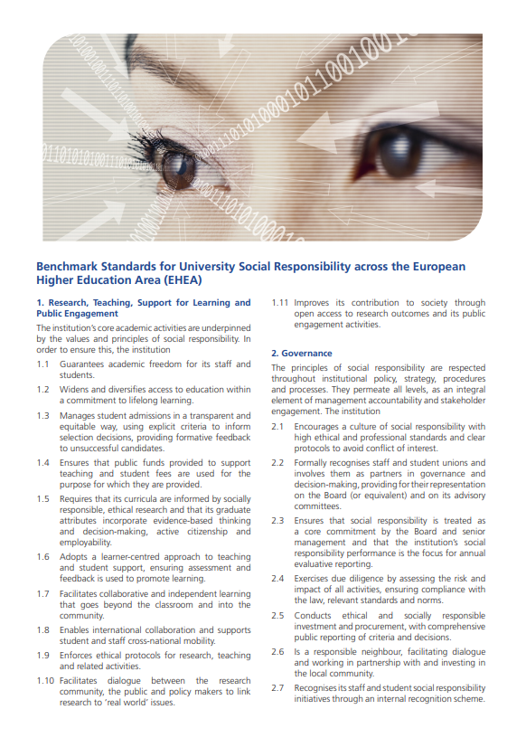
Benchmark Standards for University Social Responsibility
Research, Teaching, Support for Learning and Public Engagement
Governance
Environmental and Societal Sustainability
Fair Practices
https://www.essaproject.eu/resources/usr-standards

Slide 22
World café exercise
Learning about Benchmarking Standards:
Form groups of 3(4) persons.
Each group “owns” 2 Standards
Step 1: Using material provided, familiarise yourself with the criteria so that you could present it to your peers from another group.
Step 2: Groups rotate and share knowledge about “their” Standards.
Notes:
After forming groups (most two groups of 3(4) persons, students get handouts with material about benchmarking standards and videos with examples.

Slide 23
World café exercise: Handout
Benchmark Standard 1: Research, Teaching, Support for Learning and Public Engagement
1.1 | Guarantees academic freedom for its staff and students.
1.2 | Widens and diversifies access to education within a commitment to lifelong learning.
1.3 | Manages student admissions in a transparent and equitable way, using explicit criteria to inform selection decisions, providing formative feedback to unsuccessful candidates.
1.4 | Ensures that public funds provided to support teaching and student fees are used for the purpose for which they are provided.
1.5 | Requires that its curricula are informed by socially responsible, ethical research and that its graduate attributes incorporate evidence-based thinking and decision-making, active citizenship and employability.
Notes:
This slide will be made as a handout.

Slide 24
World café exercise: Handout
Benchmark Standard 1: Research, Teaching, Support for Learning and Public Engagement
1.6 | Adopts a learner-centred approach to teaching and student support, ensuring assessment and feedback is used to promote learning.
1.7 | Facilitates collaborative and independent learning that goes beyond the classroom and into the community.
1.8 | Enables international collaboration and supports student and staff cross-national mobility.
1.9 | Enforces ethical protocols for research, teaching and related activities.
1.10 | Facilitates dialogue between the research community, the public and policy makers to link research to ‘real world’ issues.
1.11 | Improves its contribution to society through open access to research outcomes and its public engagement activities.
Notes:
This slide will be made as a handout.

Slide 25

Video example 1
An example about university support for low-income students.
Notes:
Students will watch the video in groups.
'Hamilton' Education Program Invited Low-Income Students on Stage
https://www.youtube.com/watch?v=ade6umbKZWw

Slide 26
World café exercise: Handout
Benchmark Standard 2: Governance
2.1 | Encourages a culture of social responsibility with high ethical and professional standards and clear protocols to avoid conflict of interest.
2.2 | Formally recognises staff and student unions and involves them as partners in governance and decision-°c‐making, providing for their representation on the Board (or equivalent) and on its advisory committees.
2.3 | Ensures that social responsibility is treated as a core commitment by the Board and senior management and that the institution’s social responsibility performance is the focus for annual evaluative reporting.
2.4 | Exercises due diligence by assessing the risk and impact of all activities, ensuring compliance with the law, relevant standards and norms.
2.5 | Conducts ethical and socially responsible investment and procurement, with comprehensive public reporting of criteria and decisions.
Notes:
This slide will be made as a handout.

Slide 27
World café exercise: Handout
Benchmark Standard 2: Governance
2.6 | Is a responsible neighbour, facilitating dialogue and working in partnership with and investing in the local community.
2.7 | Recognises its staff and student social responsibility initiatives through an internal reward scheme.
2.8 | Actively participates in relevant social responsibility networks.
2.9 | Reports on its progress towards clear and independently verified social responsibility and sustainability goals.
2.10 | Publishes the outcomes of internal and external reviews, complaints, academic appeals and the source and use of all funding.
Notes:
This slide will be made as a handout.

Slide 28

Video Example 2
An example about how recycling works at the University of Edinburgh.
Notes:
Students will watch the video in groups.
How recycling works at the University of Edinburgh:
https://www.youtube.com/watch?v=KmGHsdj9oGQ

Slide 29
World café exercise: Handout
Benchmark Standard 3: Environmental and societal sustainability
3.1 | Ensures its policies and practices minimise any negative impact on the environment caused by its activities or supply chain.
3.2 | Promotes sustainable development.
3.3 | Delivers a continuous improvement programme that works towards cleaner, sustainable, eco-efficient, resource efficient, zero waste and ethical operations including procurement.
3.4 | Publishes regular environmental sustainability reports, incorporating risk and action assessments covering environmental, societal and supply chain risks.
3.5 | Encourages the use of environmentally friendly technologies, and of energy efficient, reusable and biodegradable materials.
Notes:
This slide will be made as a handout.

Slide 30
World café exercise: Handout
Benchmark Standard 3: Environmental and societal sustainability
3.6 | Practices socially responsible and sustainable procurement, publishes a code of ethical behaviour for procurement decision-making that includes workers’ rights and fair trade principles and promotes social responsibility and sustainability wherever it has influence over the supply chain.
3.7 | Ensures respect for and compliance with internationally proclaimed human rights, the rule of law and national and International anticorruption requirements.
3.8 | Ensures that all its International activities promote human and societal development and, where possible, help address the issues of poverty, quality of life, advance peace and promote conflict resolution.
Notes:
This slide will be made as a handout.

Slide 31

Video Example 3
An example about environmental sustainability at the University of Surrey.
Notes:
Students will watch the video in groups.
Environmental sustainability at the University of Surrey:
https://www.youtube.com/watch?v=TT0E2QY1Vao

Slide 32
World café exercise: Handout
Benchmark Standard 4: Fair practices
4.1 | Promotes and celebrates pluralism and diversity, and ensures equality regardless of age, culture, ethnicity, gender or sexuality.
4.2 | Practices open, transparent, fair and equitable recruitment and promotion of staff, using affirmative action where appropriate, providing comprehensive staff development that incorporates social responsibility.
4.3 | Establishes through negotiation with staff unions comprehensive employee communication, consultation and negotiation protocols and implements these.
4.4 | Promotes the health, safety, physical social and mental well-being of staff and students beyond minimum legal requirements.
4.5 | Promotes equality of opportunity, guarantees equal, fair and just pay and equitable conditions, and pro-actively works to avoid inequality through flexible working and career development and progression opportunities.
Notes:
This slide will be made as a handout.

Slide 33
World café exercise: Handout
Benchmark Standard 4: Fair practices
4.6 | Ensures that working conditions at least comply with relevant national laws, collective agreements and applicable International Labour Organisation standards and makes every effort to avoid casualisation of the workforce.
4.7 | Guarantees freedom of association and respects collective bargaining.
4.8 | Has transparent, fair and equitable complaints and disciplinary procedures and ensures that complaints and disciplinary matters are addressed swiftly and fairly.
4.9 | Publishes the possible sanctions for a proven breach of ethical or related requirements and protects whistle blowers.
4.10 | Provides professional support services to meet specific additional needs of students and staff as arising from a disability, for example.
4.11 | Communicates with suppliers about its procurement policy and uses research to inform its procurement decisions.
Notes:
This slide will be made as a handout.

Slide 34

Example 4
An example of fair trade at the University of Edinburgh.
Notes:
Students will watch the video in groups.
Fair trade at the University of Edinburgh
https://www.youtube.com/watch?v=VBVxchIiMkI

Slide 35
Analysing documentary evidence against the Benchmark Standards criteria

Slide 36
Examining documentary evidence
Before an audit you will be provided with the documents by the University to be audited.
You may also access other documentary evidence.
Any individual document may evidence a number of different reflect a number of Benchmarking criteria.
You have to learn to identify what evidence relates to the criteria and to analyse that evidence in relation to a specific criterion..
Notes:
90 minutes

Slide 37
Group task: Documentary analysis
1. Form new groups.
2. You will be provided with a document to read and to explore in relation to the Benchmarking criteria.
3. Identify which criteria you think are evidenced in the document and what the evidence indicates about the extent to which the university concerned meets these criteria?
4. Share your views within the group, reconcile any differences and prepare a brief report to present to a plenary session.

Slide 38
Present and discuss your findings with the group
What were the challenges?
Which Benchmarking criteria did you identify in the document you studied?
To what extent did the document evidence the university meeting the criteria?
What other evidence would you look for to check out this initial assessment and where would you expect to find it?
Notes:
1 hour

Slide 39
Questions and check-out

Slide 40

Check-out
Time for questions and answers:
3 things that you have learned today.
2 things that are still not clear to you.
1 question you would like to give to your facilitator.
Revision of learning expectations.

